Slide 1
CS Advanced Computer Architecture
Module 1

Slide 2
What is *Computer Architecture*
Computer Architecture =
Instruction Set Architecture +
Organization +
Hardware + …
Why ???
--- Lets go ahead on further slides…

Slide 3
Why Study Computer Architecture
Answer #2: technology playing field is always changing
Annual technology improvements (approx.)
Designs change even if requirements are fixed. But the requirements are not fixed.

Slide 4
Example of Changing Designs
Having, or not having caches
1970: 10K transistors on a single chip, DRAM faster than logic → having a cache is bad
1990: 1M transistors, logic is faster than DRAM → having a cache is good
2000: 600M transistors -> multiple level caches and multiple CPUs
Will caches ever be a bad idea again?

Slide 5
Performance Growth in Perspective
Same absolute increase in computing power
Big Bang – 2001
2001 – 2003
1971 – 2001: performance improved 35,000X!!!
What if cars or planes improved at this rate?
So, why??
Maximization of CPU performance is always a demand of computer architect.

Slide 6
How to maximize CPU Performance
By improving the performance of a single computer [within CPU]
(Uniprocessing/Conventional Approach/ Von Neumann Architecture)
How??
Increase clock rate, using faster memories and caches, pipelining at instruction level.

Slide 7
How to maximize CPU Performance
By parallel processing [with many CPU]
How??
Many CPU are employed (PE)*
Architecture used to solve these problems are known as Advanced Computer Architecture.
Algorithm used here is known as Parallel Algorithm.
Programming of these computer is known as Parallel Programming

Slide 8
Need for parallel computing??
First recall classes of computers-
Low cost/power(Laptop)→ Balanced cost/performance(Workstation/Servers)→ High performance (supercomputers)
Examples??
Several reasons but most important are:-
To save time and cost
To provide concurrency i.e, parallel execution of tasks.

Slide 9
Applications and Requirements
Scientific/numerical: weather prediction, molecular modeling
Need: large memory, floating-point arithmetic
Commercial: inventory, payroll, web serving, e-commerce
Need: integer arithmetic, high I/O
Embedded: automobile engines, microwave, PDAs
Need: low power, low cost, interrupt driven
Home computing: multimedia, games, entertainment
Need: high data bandwidth, graphics

Slide 10
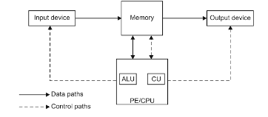
Constraints of conventional architecture
PE receives one instruction of program at a time, interprets it and executes it (Thus operation is parallel**)
At a time PE executes many** instruction (Thus the speed of sequential computer depends on the speed on which PE retrieves instruction and at which it process retrieved data.

Slide 11
Constraints of conventional architecture
To increase speed many such sequential computer works together.
Such a computer which consists of number of interconnected sequential computers which cooperatively?? Executes a single program to solve a problem is called parallel computer.

Slide 12
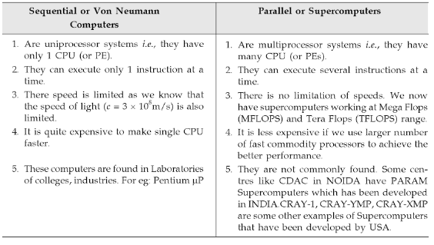
Sequential v/s parallel computers

Slide 13
MFLOPS (Mega Flops)
A machine which is capable of performing one floating poin operation every 10ns has a speed of (1/10^-8)= 100 mega flops i.e, 100 million (mega) floating point operation per second.

Slide 14
Measuring Performance
Latency (response time, execution time)
Minimize time to wait for a computation
Energy/Power consumption
Throughput (tasks completed per unit time, bandwidth)
Maximize work done in a given interval
= 1/latency when there is no overlap among tasks
> 1/latency when there is
In real processors there is always overlap (pipelining)
Both are important (Architecture – Latency is important, Embedded system – Power consumption is important, and Network – Throughput is important)
Notes:
Response time, elapsed time, wall-clock time.

Slide 15
Performance Terminology
“X is n times faster than Y’’ means:
Execution time_{Y}
Execution time_{X}
= n
“X is m% faster than Y’’ means:
Execution time_{Y} - Execution time_{X}
Execution time_{X}
X 100%
= m

Slide 16
Compute Speedup – Amdahl’s Law
Speedup is due to enhancement(E):
Time_{Before}
Time_{After}
Execution time w/o E (Before)
Execution time w E (After)
Speedup (E) =
Suppose that enhancement E accelerates a fraction F
of the task by a factor S, and the remainder of the task
is unaffected, what is the Execution time_{after} and Speedup(E) ?

Slide 17
Amdahl’s Law
Execution time_{after}
= ExTime_{before} x [(1-F) +
F
S
]
ExTime_{before}
ExTime_{after}
1
Speedup(E)
=
=
[(1-F) +
F
S
]

Slide 18
Amdahl’s Law – An Example
Q: Floating point instructions improved to run 2X;
but only 10% of execution time are FP ops. What is the execution time and speedup after improvement?
Ans:
F = 0.1, S = 2
ExTime_{after} = ExTime_{before} x [ (1-0.1) + 0.1/2 ] = 0.95 ExTime_{before}
ExTime_{before}
1
0.95
Speedup =
=
= 1.053
ExTime_{after}
Read examples in the book!

Slide 19
CPU Performance
The Fundamental Law
Three components of CPU performance:
Instruction count
CPI
Clock cycle time

Slide 20
CPI - Cycles per Instruction
Let Fi be the frequency of type I instructions in a program. Then, Average CPI:
Example:
average CPI = 0.43 + 0.42 + 0.24 + 0.48 = 1.57 cycles/instruction

Slide 21
Example
Instruction mix of a RISC architecture.
Add a register-memory ALU instruction format?
One op. in register, one op. in memory
The new instruction will take 2 cc but will also increase the Branches to 3 cc.
Q: What fraction of loads must be eliminated for this to pay off?

Slide 22
Solution
Instr. | F_{i} | CPI_{i} | CPI_{i}xF_{i} | I_{i} | CPI_{i} | CPI_{i}xI_{i}
ALU | .5 | 1 | .5 | .5-X | 1 | .5-X
Load | .2 | 2 | .4 | .2-X | 2 | .4-2X
Store | .1 | 2 | .2 | .1 | 2 | .2
Branch | .2 | 2 | .4 | .2 | 3 | .6
Reg/Mem |  |  |  | X | 2 | 2X
 | 1.0 |  | CPI=1.5 | 1-X |  | (1.7-X)/(1-X)
Exec Time = Instr. Cnt. x CPI x Cycle time
Instr. Cnt_{old} x CPI_{old} x Cycle time_{old} >= Instr. Cnt_{new} x CPI_{new} x Cycle time_{new}
1.0 x 1.5 >= (1-X) x (1.7-X)/(1-X)
X >= 0.2
ALL loads must be eliminated for this to be a win!

Slide 23
MIPS and MFLOPS
MIPS: millions of instructions per second:
MIPS = Inst. count/ (CPU time * 10**6) = Clock rate/(CPI*10⁶)
easy to understand and to market
inst. set dependent, cannot be used across machines.
program dependent
can vary inversely to performance! (why? read the book)
MFLOPS: million of FP ops per second.
less compiler dependent than MIPS.
not all FP ops are implemented in h/w on all machines.
not all FP ops have same latencies.
normalized MFLOPS: uses an equivalence table to even out the various latencies of FP ops.

Slide 24
Improve Memory System
All instructions require an instruction fetch, only a fraction require a data fetch/store.
Optimize instruction access over data access
Programs exhibit locality
Spatial Locality
Temporal Locality
Access to small memories is faster
Provide a storage hierarchy such that the most frequent accesses are to the smallest (closest) memories.
Memory
Disk/Tape
Registers
Cache

Slide 25
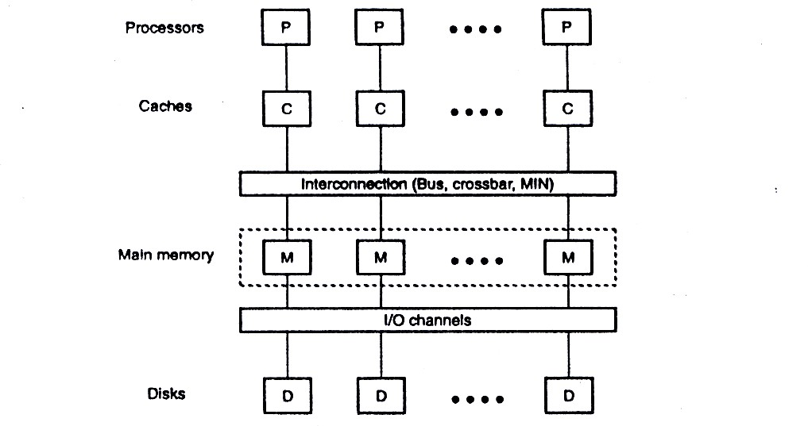
Memory Hierarchy for a Shared-Memory Multiprocessor

Slide 26
Shared-Memory Organization
In parallel processors higher memory bandwidth is needed
Shared memory consists of multiple memory modules
Memory accesses to memory modules can be done in parallel or can be pipelined to increase the bandwidth
Memory interleaving is a mechanism to allow memory access pipelining

Slide 27
Memory Interleaving
Memory access:
Random access
Block access:
A block of consecutive addresses are accessed
Memory organization should facilitate block accesses
The performance depends on memory interleaving mechanism
Low order interleaving
High order interleaving

Slide 28
Memory Modules
m = 2^a memory modules
w = 2^b cells of words per memory module
Total memory capacity = mw = 2^(a+b) words
Linear addresses are assigned to these memory words
Addresses can be assigned in two different ways resulting in low-order or high-order memory interleaving

Slide 29
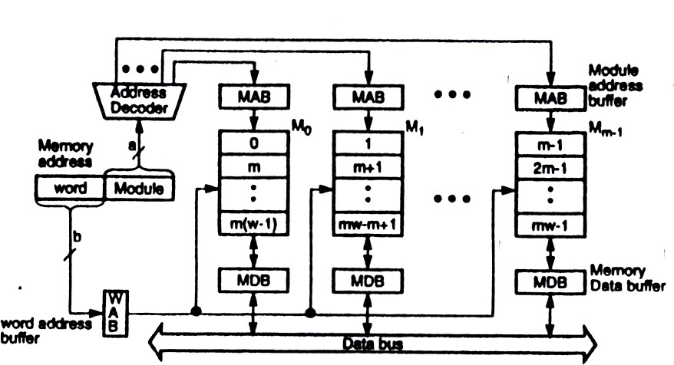
Low-Order Memory Interleaving

Slide 30
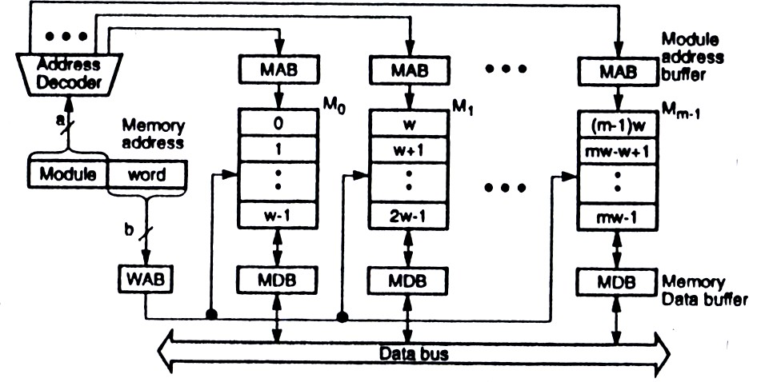
High-Order Memory Interleaving
High-order memory interleaving cannot support pipelined block access of contiguous memory locations

Slide 31
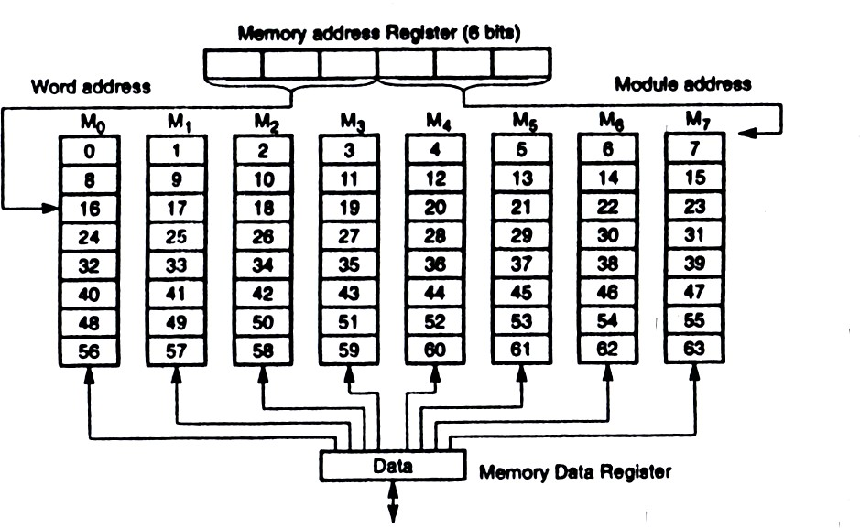
Eight-way Low-order Interleaving
m=8 w=8 a=b=3

Slide 32
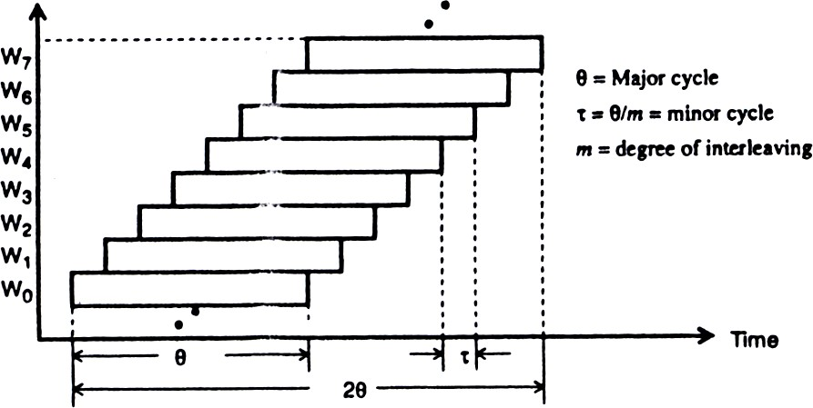
Pipelined Memory Access
C-access memory scheme:
Concurrent access of contiguous words in a pipelined fashion
Θ = The total time to complete the access of a single word
τ = The actual time needed to produce the word in pipelined architecture

Slide 33

Memory Bandwidth
The C-access is suitable for vector processing computers
The average vector access time assuming that n elements are stored in an m-way low-order memory system is:
[Θ+(n−1) τ]/n , τ = Θ/m
For long vectors t1=Θ/m=τ
For scalar access n=1 and t1=Θ

Slide 34
Fault Tolerance
In a low-order interleaved memory system if one memory module fails the system will be paralyzed
In a high-order interleaved memory system if one module fails the system can still be used by isolating the failed modules address space
A combination of low-order and high-order memory organizations can be used to achieve fault tolerance while increasing the block access bandwidth

Slide 35
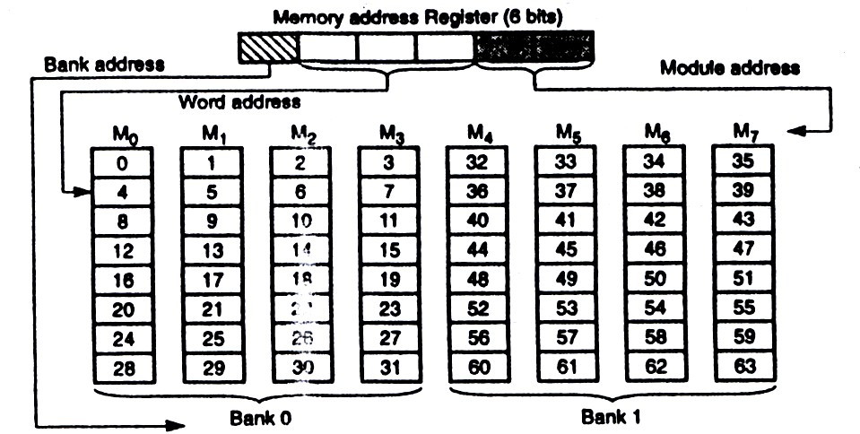
Two Memory Banks with Four-way Interleaving

Slide 36
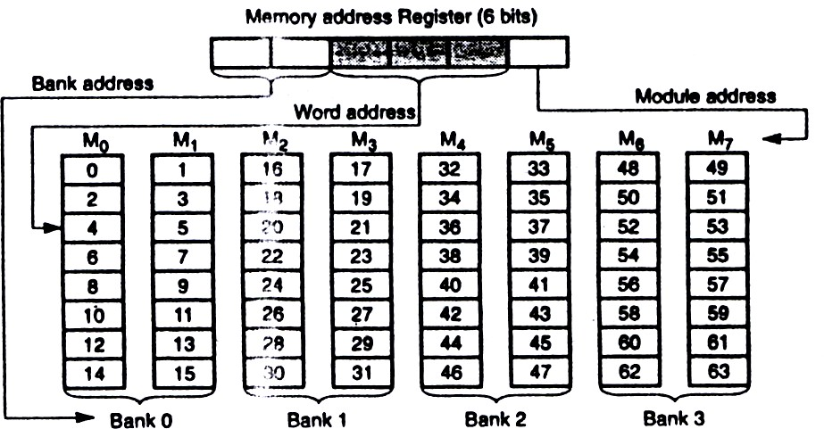
Four Memory Banks with Two-way Interleaving

